Slide 1

Database & Database Applications
Chapter 3:Entity-Relationship Model

Slide 2
Outline
Entity Relationship Model (ER)
Data design process steps
What is an Entity?
Types of Attributes
Keys
Relationship
Cardinality Ratio
Participation Constraints
Weak Entity Types
Alternative Notation for ER Diagrams
Example Database Application

Slide 3
Entity Relationship Model (ER)
ER model was proposed by Peter Chen in 1976
ER model has become the standard tool for conceptual schema design
ER model consists of three basic constructs: entities, attributes and relationships.
ER model is considering as high level conceptual data model.
There is a diagram is close to ER diagram and it is called class diagram.

Slide 4
Data design process steps
1st step: requirement collection and analysis.
  Interview with DB user to specify data requirements.
  Specify functional requirement of application like (data flow diagram, sequence diagram, scenario’s).
2nd step: Create conceptual schema for the DB (AKA: Conceptual Design).
  Describe Entity type, relationships, constrains.
  No implementation details in the phase.
3rd step: actual implementation of the DB (AKA logical design or data model mapping)
  By using commercial DBMS.
  It transfers conceptual schema from high level data model into the implementation data model.
4th step: physical design.
  Internal storage structure.
  File organization.
  Indexes.
  Access path.
  Physical design parameters.

Slide 7
What is an Entity ?
Entity: is a “thing” in the real world with an independent existence,
Entities are specific objects or things in the mini-world that are represented in the database.
It may be an object with physical existence (e.g. person, car, house, employee), or it may be an object with conceptual existence ( job, course).

Slide 8
Entity
Two types of entities:
  Strong entity: can exist independently (or can uniquely identify itself)
  Weak entity: existence depends on the existence of other (strong) entity or entities
Examples:
  An employee is a strong entity but the dependents of the employee could be weak entities
  An account in a bank is a strong entity but a transaction could be a week entity
An entity type defines a set of entities that have the same attributes.
  STUDENT is an entity type (Schema).

Slide 9
Entity Set
An Entity set is a collection of entities of the same entity type
Examples:
  Rema, Ali, Amal, Samer, Rana are entity set of an entity type STUDENT

Slide 10
Attributes
An Entity has a set of Attributes that describes it.
Attributes are properties used to describe an entity.
  Person(SSN, Name, Address, Job-description, Salary).
An entity will have a value for each of its attributes
(999-010-201, John Smith, ‘20 Alebany Rd, Cardiff, UK’, ‘Manager’, 2500)
The properties of an entity set are called attributes of the entity set.
  Students: SSN, Name, Address, GPA, Status, ...
  Books: Title, ISBN, Authors, Publisher, Year, ...

Slide 11
Types of Attributes
Simple (or atomic) attribute
Composite attribute
single-valued attribute
multi-valued attribute
stored attribute
Derived-attributes

Slide 12
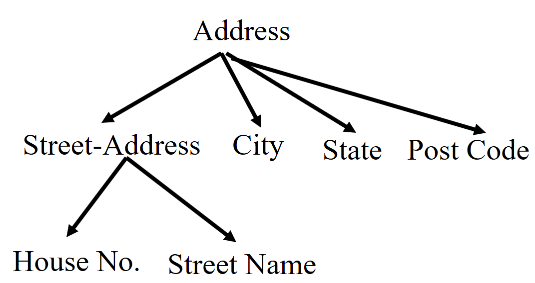
Simple vs. Composite
Simple (or atomic) attribute is a one which cannot be divided into smaller parts.
  Examples: SSN, GPA, Salary.
Composite attribute is an attribute which can be divided into smaller subparts, these subparts represent more basic attributes with independent meanings of their own.
  Examples: Name: First_Name, Middle_Name, Last_Name
  Address: Street_Address, City, State, Zip code.

Slide 13
Single-valued vs. Multi-valued
A single-valued attribute is a one which has one (single) value for a particular entity.
  Example: Age, BirthDate
A multi-valued attribute is a one which may have one or more values for the same entity.
  College Degrees for Person: 0, 1, 2, 3, …
  Color for a Car: 1, 2, …..
  Authors of Books
  Phone Number

Slide 14
Stored vs. Derived
A stored attribute is a one whose value is explicitly stored in the database.
  e.g. name, birth-date.
Derived-attributes: whose values are computed from other attributes.
  Age from Birthdate
  Annual Salary from Monthly Salary
  NoOfEmployees ==> Count number of employees in the Employee table.

Slide 15
Null Values
An attribute may have null as its value.
Null may mean
  not applicable (college degree)
  Unknown
    Missing (height of Ali)
    Not known (home phone for Ali).

Slide 16
Keys
Key attribute is an attribute whose values are distinct (unique) for a given entity type.
Keys may be
  simple: one attribute (SSN), or
  composite: a set of attributes whose values together uniquely identify an entity type
Name(first name, father name, grandfather name, family name)

Slide 17
Relationship
A relationship type is represented as diamond-shaped box which is connected by straight lines

Slide 18
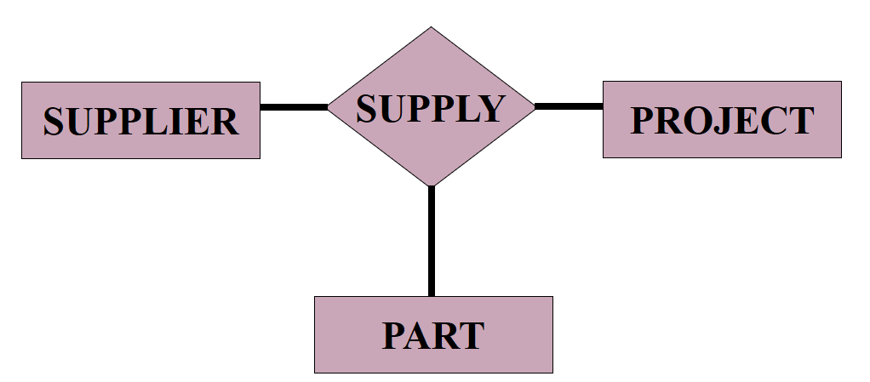
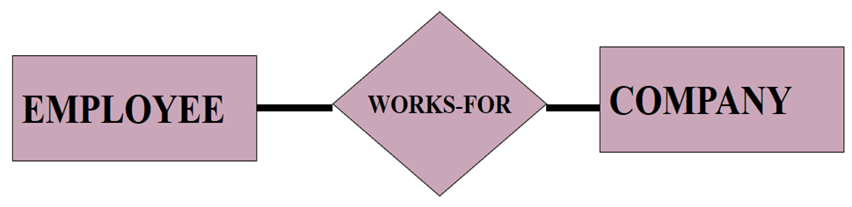
Relationship Degree
Degree of a relationship type is the number of participating entity types: binary relationships, ternary relationships, ….
Binary Relationships
Ternary Relationships

Slide 19
Recursive Relationships
The role name signifies the role that a participating entity from the entity type plays in each relationship instance
So, entity e1 plays the role of a supervisor, while entity e2 plays the role of a supervisee
EMPLOYEE
SUPERVISES
MARRY
PERSON

Slide 20
Cardinality Ratio
Specifies the number of relationship instances that an entity can participate in
Common cardinality ratios for binary relationship types are:
  1:1,
  1:N, and
  M:N.

Slide 21
Cardinality Ratio (1:N)
An employee works for one company, and a company has many employees working for it.
WORKS-FOR
N
1
COMPANY
EMPLOYEE

Slide 22
Cardinality Ratio (1:1)
A department has one manager, and a manager manages one department.
HAS
1
1
MANAGER
DEPARTMENT

Slide 23
Cardinality Ratio (N:M)
An employee works on many projects, and a project has many employees working on it.
WORKS-ON
EMPLOYEE
M
N
PROJECT

Slide 24
Participation Constraints
Specifies whether the existence of an entity depends on its being related to another entity via the relationship type.
There is Total and Partial participation.

Slide 25
Total Participation
WORKS-FOR
N
1
DEPARTMENT
EMPLOYEE
Total participation.
Every employee MUST be related to a department via WORKS-FOR relationship. A department must have at least one employee.

Slide 26
Partial Participation
1
BUYS
N
PERSON
CAR
Partial Participation.
A person MAY Buy a car and car may be bought by a person

Slide 27
Total & Partial Participation
A professor may manage a department (partial participation), but a department must be managed by a professor (total participation).
1
1
PROFESSOR
MANAGES
DEPARTMENT

Slide 28
Attributes of Relationship Types
Works-for
N
1
EMPLOYEE
DEPARTMENT
Start-Date
We may keep a start date attribute to record for each employee the date he/she started work for a certain department.

Slide 29
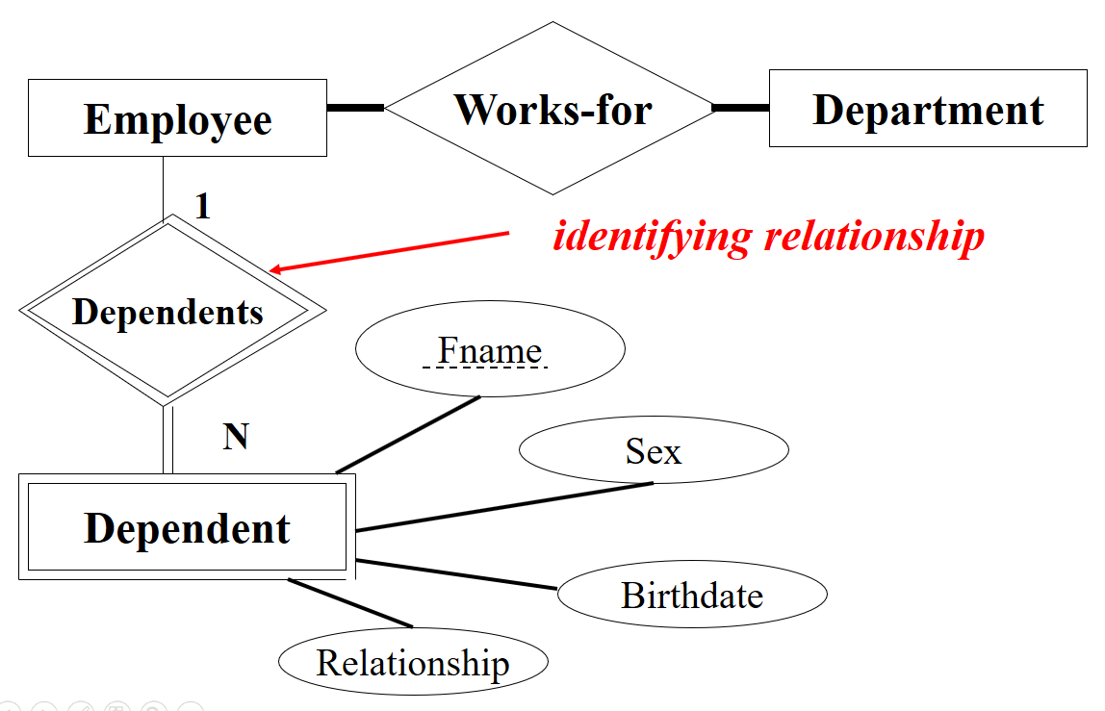
Weak Entity Type
A weak entity type is an entity which does not have any key attributes:

Slide 30
Weak Entity Types
A weak entity type always has a total participation with its identifying entity type
A Weak entity type has a partial key, i.e. this key is enough to identify its extension within the scope of its identifying entity type
In the previous example, the first name is enough to identify kids within a single family, but is not enough to identify entities as stand alone entities (two families may use identical names for their kids)

Slide 31
Wrapping
Weak Entity Type
Entity type that DO NOT have a key attributes of their own called Weak Entity Type.
In contrast regular entity type that have key attribute is called Strong Entity Type
Entities belonging to a weak entity type are identified by being related to a specific entity from another entity type that called identifying OR owner entity type.
We called the relationship of the weak entity type identifying relation of the weak entity type.
Weak entity type always has total participation.
Weak entity type normally has partial key.
Partial key is the attribute that can uniquely identify weak entities that are related to the same owner entity.
There are two ways to solve key issue for weak entity type:
  Either we select one attribute from the weak entity type and make it as a key. OR
  Create a composite key that made up from all attributes in the weak entity type.

Slide 32
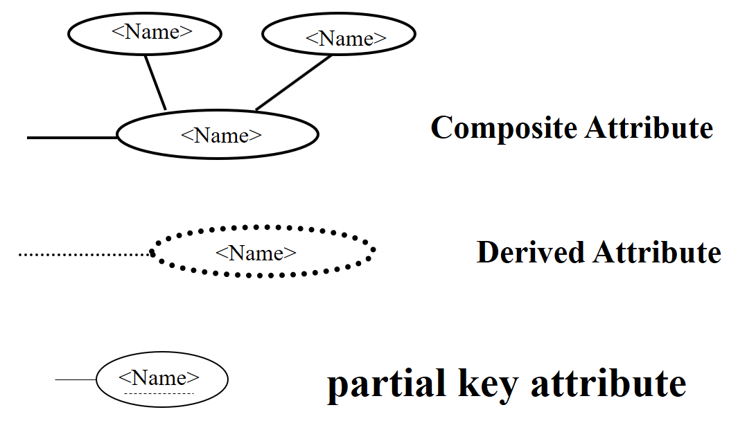
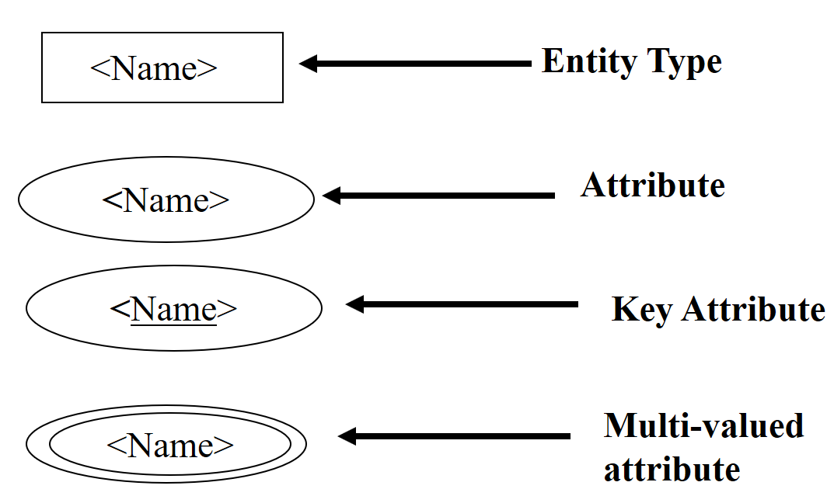
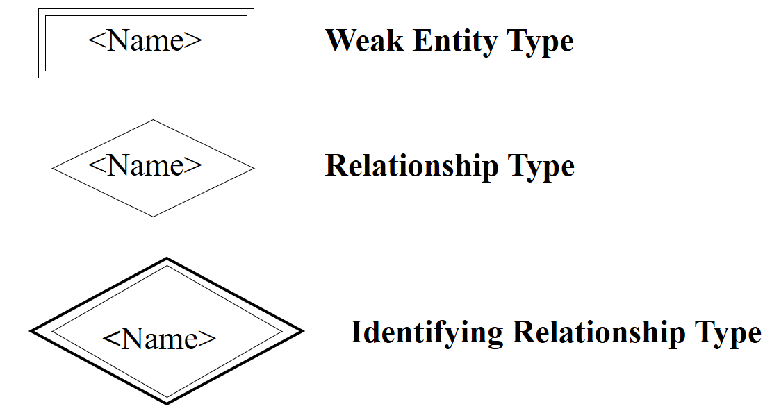
ER Diagram Notations

Slide 33
ER Diagrams Notation Rules
Entity Types
  singular name, capital letters
Relationship Types
  usually singular verbs, capital letters
Attribute
  nouns, capitalized
Role names
  are in lowercase letters
ER diagrams are drawn such that they are readable from left to right and top to bottom (Except weak entity types)

Slide 34
Role of an Entity Set (1)
Definition: The role of an entity set in a relationship is the function it performs in the relationship.
Case 1: Role can be determined from properly chosen names.
m
TAKES
n
STUDENT
COURSE
1
IS_TA_OF
1

Slide 35
Role of an Entity Set (2)
Case 2: Roles need to be explicitly given.
IS_MARRIED_TO
SUPERVISES
1
1
1
m
wife
husband
supervisor
supervisee
PERSON
EMPLOYEE

Slide 36
Attribute of Relationship
Where to keep the grade information?
m
TAKES
n
STUDENT
COURSE
grade

Slide 37
Alternative Notation for ER Diagrams
One in ER model means zero or one
Many in ER model means zero or more
Cardinality constraints make them more precise
(1, 5)
(5, 60)
STUDENT
TAKES
COURSE

Slide 38
Alternative Notation for ER Diagrams
General format:
0 ≤ min_card ≤ max_card
  Interpretation:
  Each entity in E may involve between min_card and max_card relationships in R.
(min_card, max_card)
E
R

Slide 39
Alternative Notation for ER Diagrams
Definition:
  If every entity in E involves at least one relationship in R (i.e., min_card >= 1), E is said to have Total Participation in R
  If min_card = 0, E is said to have Partial Participation in R

Slide 40
Alternative Notation for ER Diagrams
Employees has a partial participation.
Departments has a total participation.
EMPLOYEE
(0, 1)
(1,1)
MANAGES
DEPARTMENT

Slide 41
Example
Database Application
Company Database

Slide 42
Steps/Tips to Solve a Scenario
To solve the ER scenario, you need to follow these step:
Read the whole scenario for the first time and extract only:
  Entity type
  Attributes
Read the whole scenario for the second time and extract only:
  Relationships between Entity types.
Read the whole scenario for the Third time and check the participation (Total & Partial).
Read the whole scenario for the last time and revise everything.

Slide 43
Company Database (Example)
The Company database keeps track of a company’s
  Employees, Departments, Projects
The following are the requirements and specifications
The company is organized into departments.
Each department has a:
  unique name, unique number
  particular employee who manages the department
We keep track of the start date when that employee began managing the department
A department may have several locations

Slide 44
Company Database (Example)
A department controls several projects, each of which has a
  unique name, unique number, and single location
We store each employee’s
  name, social security number, address, salary, sex, and birth date.
An employee is assigned to one department but may work on several projects, which are not necessarily controlled by the same department
We keep track of the number of hours per week that an employee works on each project
We keep track of the direct supervisor of each employee

Slide 45
Company Database (Example)
We want to keep track of the dependents of each employee for insurance purposes.
We keep each dependent’s first name, sex, birth date, and relationship to the employee

Slide 46
Example
Database Application
Company Database
Solution

Slide 47
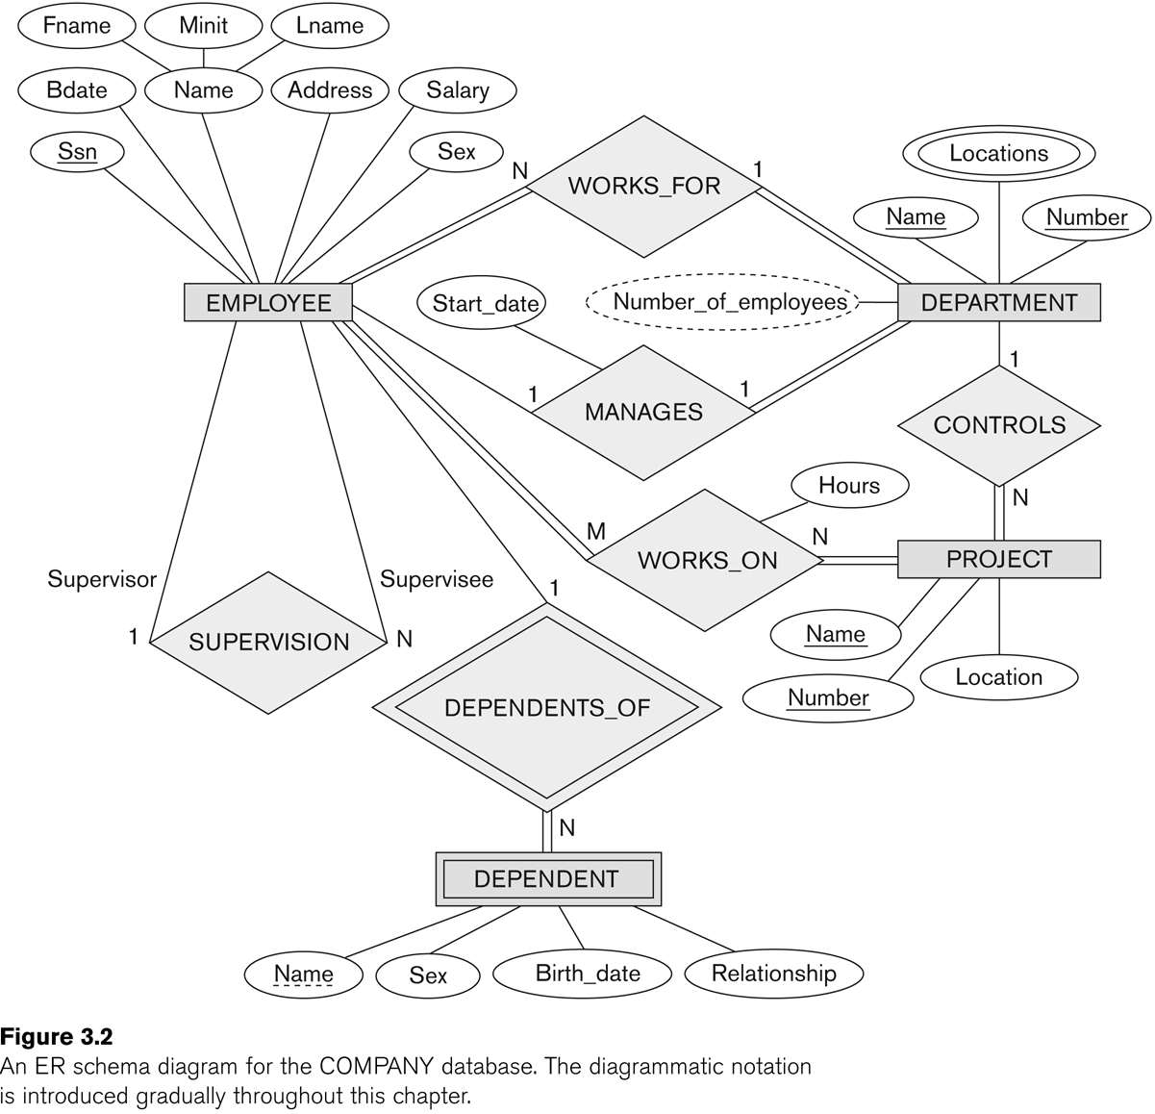

Slide 48
THE END

